Slide 1
Understanding the Relationship Between the Circumgalactic Medium and the Interstellar Medium
Martin Flores Department of Physics, Arizona State University
Dr. Sanchayeeta Borthakur & Chris Dupuis School of Earth and Space Exploration, Arizona State University
April 13, 2019
Arizona Space Grant Consortium Statewide Symposium

Slide 2
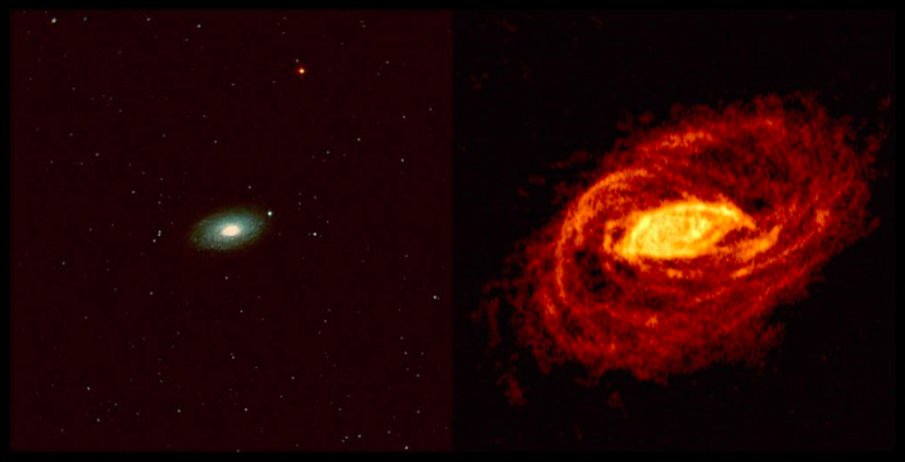
Circumgalactic Medium
NGC 5055 (same scale)
Optical Radio, 21 cm
Generally contains as much mass as stars
Influence on galaxy formation is still not fully understood.
Battaglia et al. 2005
1

Slide 3
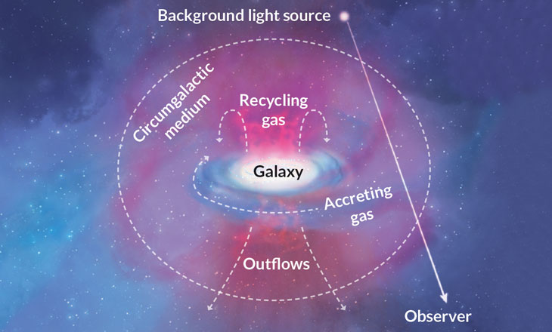
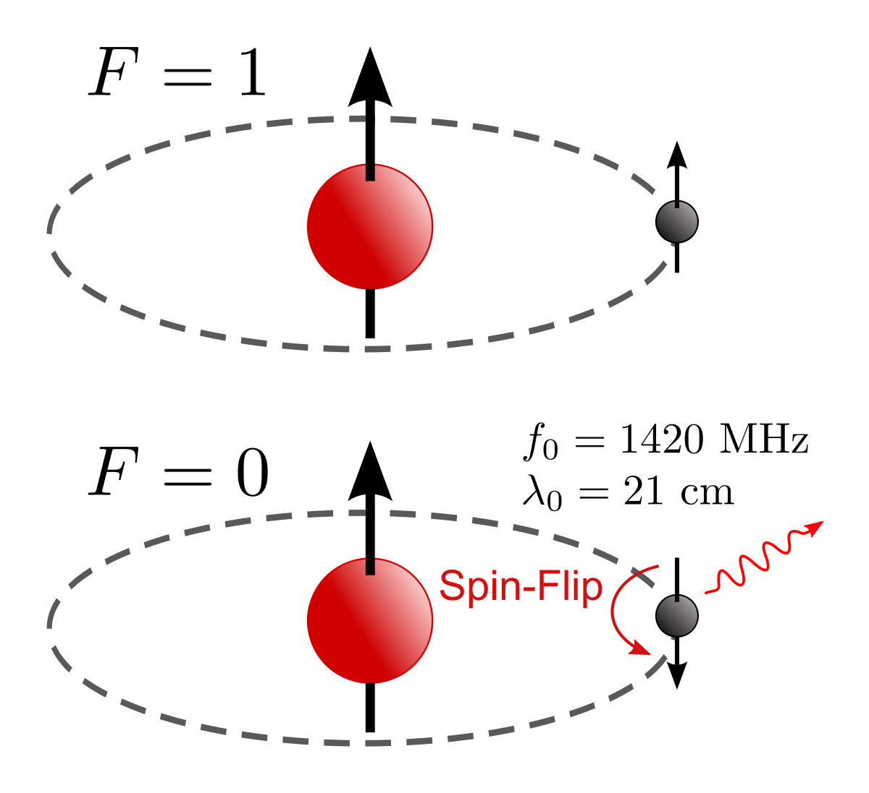
Probing the Gas Reservoirs
Illustration from Tumlinson, Peeples, Werk 2017 ARAA
2

Slide 4
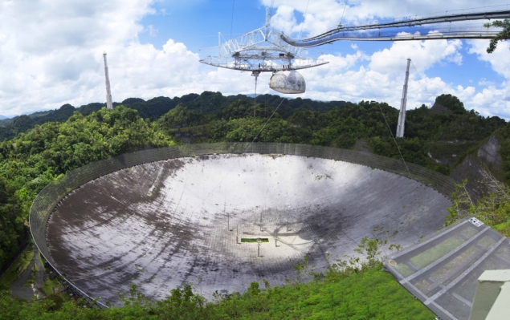
Probing the Gas Reservoirs
Arecibo Telescope
ISM data gathered with the GBT and Arecibo telescope (HI 21cm emission)
27 galaxies
Lyα absorption data obtained from the Hubble Space Telescope program COS-Dwarfs
42 galaxies.
Green Bank Telescope
by Mark Williamson
by Eric Purcel
3

Slide 5
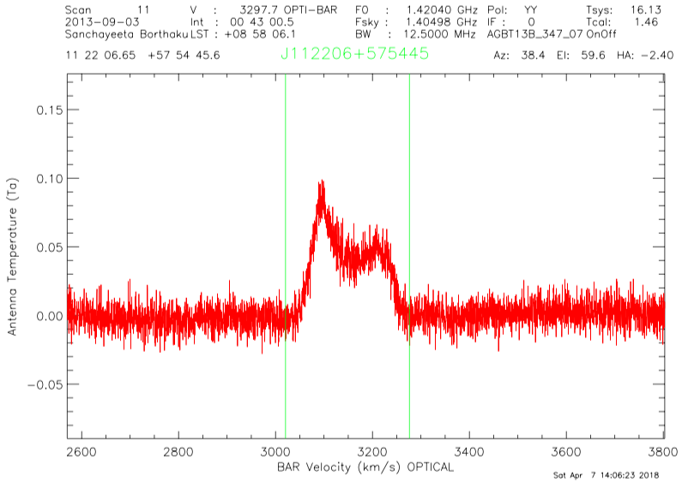
Data Reduction
Reduced using GBTIDL
Eight of the 16 GBT targets reflected HI emission
A limiting equivalent width of 3 times the noise of the spectra is reported for 5 galaxies classified as non-detections.
Three of the target spectra were corrupted by different absorption systems
$$M\left(HI\right)=2.36×{10}^{5}D^{2}\left(SAV\right)M_{⊙}$$
(D is the luminosity distance in Mpc and SAV is the flux density)
4

Slide 6
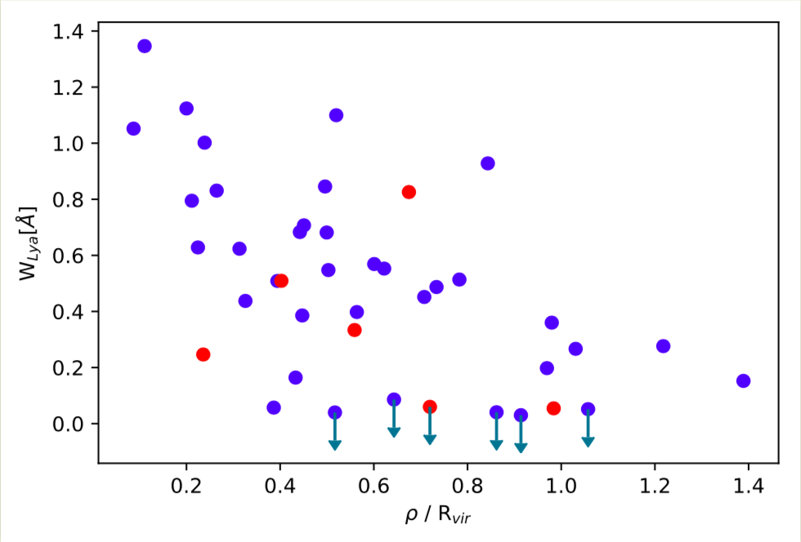
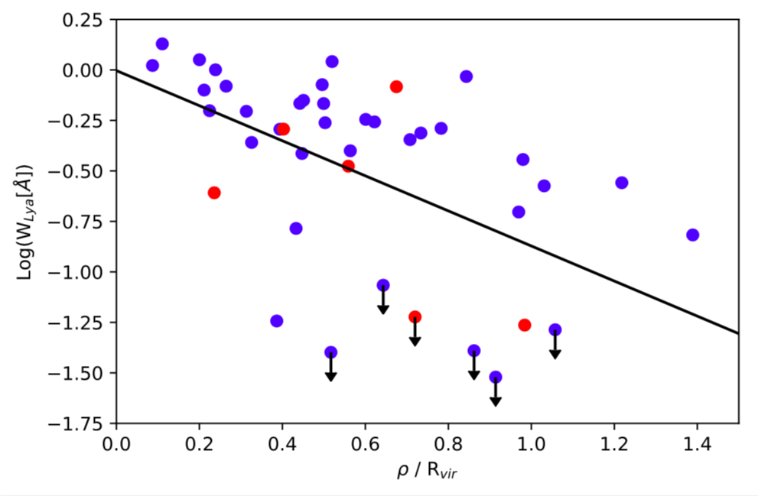
Interpreting Ly⍺ Measurements
$$Log\left(W_{Lyα}\right)=(−0.8684±0.1674)\frac{ρ}{R_{vir}} −0.0033 ±0.1057$$
5

Slide 7
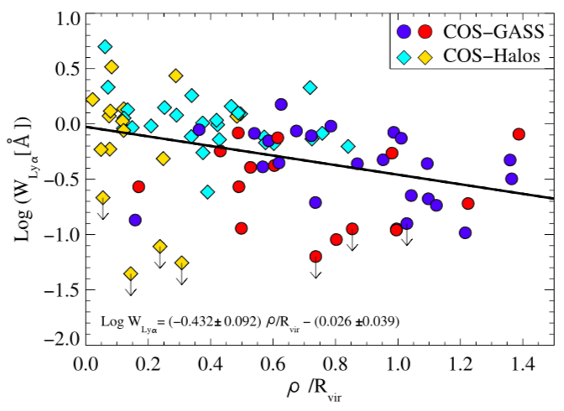
Interpreting Ly⍺ Measurements
L* survey (expectation)
GBT-Dwarfs & Arecibo Dwarfs
$$Log\left(W_{Lyα}\right)=(−0.8684±0.1674)\frac{ρ}{R_{vir}} −0.0033 ±0.1057$$
Borthakur et al. 2015
6

Slide 8
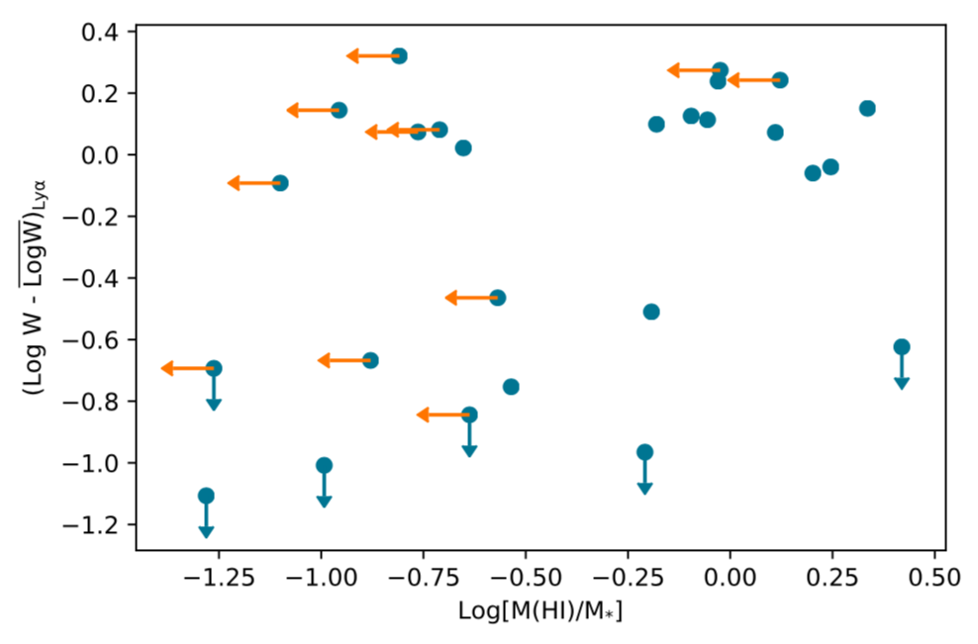
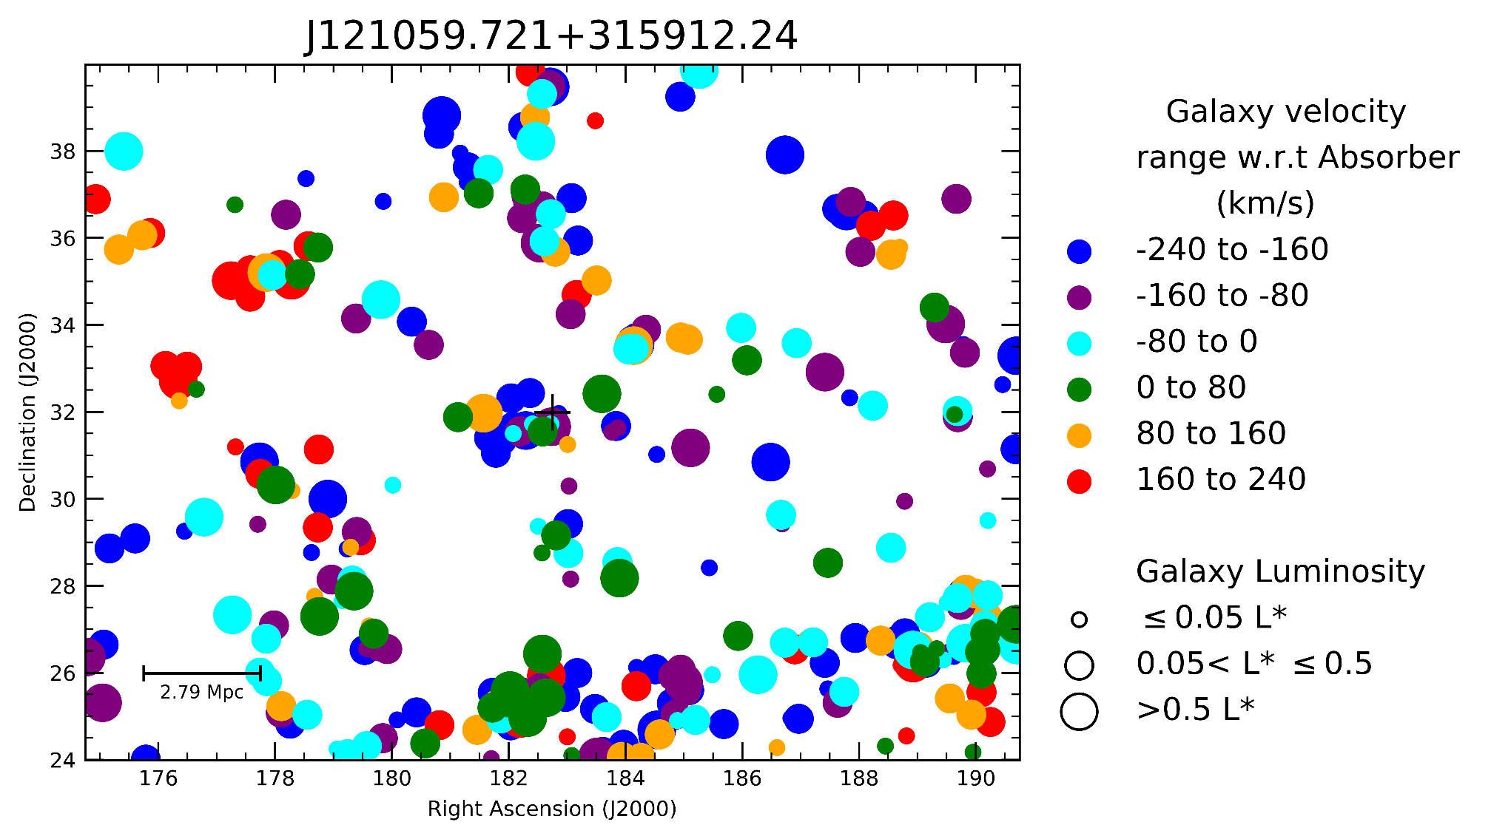
Connecting the Gas Reservoirs
7

Slide 9
Summary and Future Work
Galaxies show a very good Lyman alpha covering fraction in the inner CGM.
Gaps in the neutral gas envelope in the outer CGM of these galaxies.
No correlation between the strength of Lyα in the CGM and HI content in the ISM of galaxies.
Perhaps gaps the in the CGM are a result of loss of circumgalactic gas via feedback owing to the lower halo masses.
Future: multidimensional clustering analysis & potentially obtain more data.
8

Slide 10
Thank you!
Questions?
Martin Flores
maflor36@asu.edu
9

